Slide 1
Hotel Booking Analysis
Capstone Project
By – Bhumika singh

Slide 2
Point to Discuss :-
Overview
Data Summary
Importance of Hotel booking analysis
Business objective
Dataset first view
Dataset last view
Dataset columns
Pie chart/bar chart/correlation heatmap
Conclusion

Slide 3
OVERVIEW
Understanding the nuances of hotel booking patterns is essential for optimizing income, raising customer happiness, and preserving a competitive edge in today's fast-paced and cutthroat hospitality market. Analyzing hotel bookings is a potent technique for drawing insightful conclusions from the enormous amount of data produced during regular business operations. This thorough review explores the main components of hotel booking analysis, illuminating its importance, working methods, and possible influence on choices.

Slide 4
Data Summary
Hotel : Kind of hotel (Resort or City)
is_cancelled : Whether the reservation was canceled(1) or not (0)
Lead_time: Days that are left before the guests actually arrive
arrival_date_year: Year of arrival date
arrival_date_month: Month of arrival date
arrival_date_week_number : The week and year of the arrival
arrival_date_day_of_month: Day of arrival date
stays_in_weekend_nights:How many weekends (Saturday or Sunday) do customers stay at the hotel?
stays_in_weel_nights:The number of weeknights (Monday through Friday) that visitors stay at the hotel.
adults: Number of adults among the guests
children: Number of children
babies: Number of babies
meal: Type of meal booked
country: country of the guests

Slide 5
Data Summary
market_segment: Segmentation of the market
distribution_channel: The channel name for booking distribution
is_repeated_guest: If the reservation came from a returning customer(1) or not (0)
previous_cancellation: The number of earlier reservations that the client canceled before the current reservation
previous_bookings_not_cancelled: The number of prior bookings that the customer did not cancel before the current booking
reserved_room_type: Code from room type reserved
assigned_room_type: Code of room type assigned
booking_changes: Number of changes made to the booking
deposit_type: Type of deposit made by the guest
agent: ID of travel agent who made the booking
comapny: ID of the company that made the booking
days_in_waiting_list: Number of the days the booking was in the waiting list
customer_type: Type of customer, assuming one of four categories
adr: Average daily rate
required_car_parking_spaces : The quantity of parking spaces needed, but the client
total_of_special_requesrs: The quantity of unique requests the client has made
reservation_statuse: Status of reservation (cancelled, checked out, or no-show)
reservation_status_date: Date of the most recent update to the reservation status

Slide 6
Importance of Hotel booking analysis
Global events, shifting economic conditions, and ever-changing consumer preferences are the hallmarks of the hospitality industry's operating environment. Hoteliers may interpret patterns, spot trends, and make wise decisions by using hotel booking data as a strategic lens. Hotels may adapt and prosper in a competitive market by using the insights gained from analysis to customize services based on customer segments and optimize pricing strategies.

Slide 7
Business Objective
We will be analyzing a dataset of hotel bookings in this project. This dataset comprises details about city hotels and resort hotels, including details about available parking spaces, length of stay, number of adults, kids, and/or babies, and booking time.
This project's goal is to investigate and evaluate the data in order to identify significant elements pertaining to hotel reservations and their characteristics. and offer some adjustments that might later be profitable for the hotel.

Slide 8
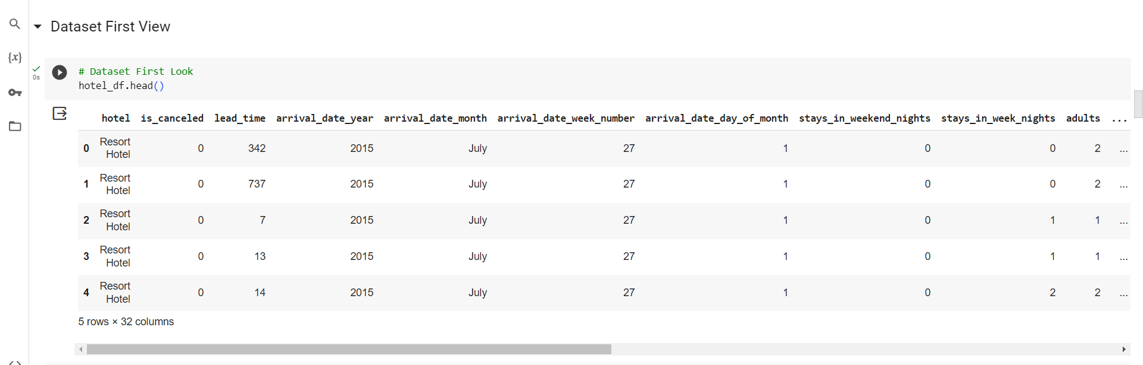
Dataset First View

Slide 9
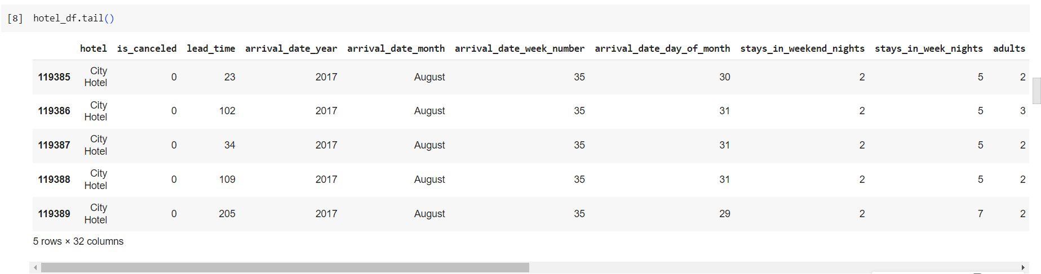
Dataset last view

Slide 10
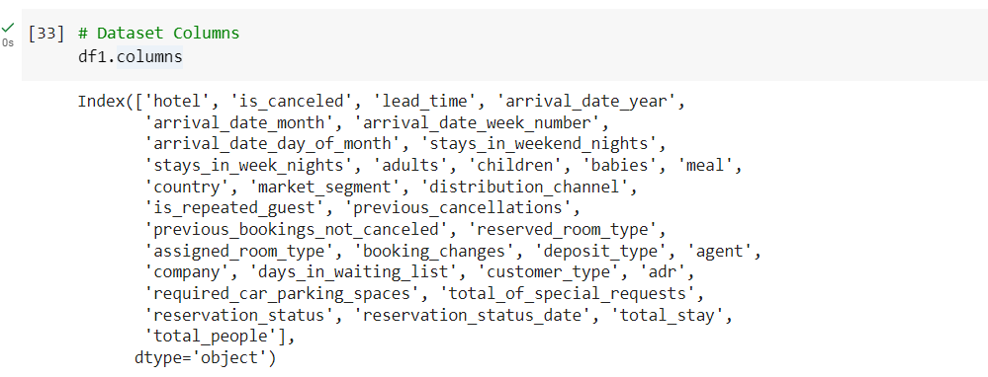
Dataset columns

Slide 11
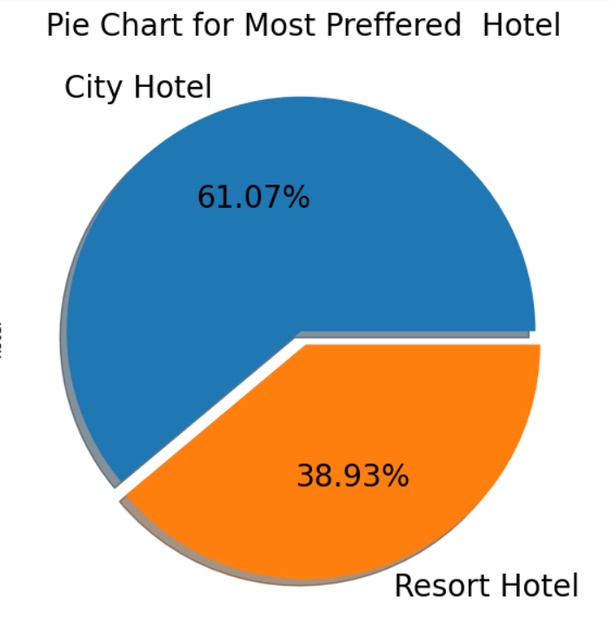
Which type of hotel is mostly preferred by the guests?
1. We discovered that 61.07% of bookings are at the city hotel, while 38.93% are at the resort hotel.
2. Indeed, newfound understanding contributes to a successful business outcome.
The city hotel can find additional services to draw in more visitors and boost earnings.
In addition to determining which amenities the city hotel offers to draw guests, resort hotels are able to find ways to draw in guests.

Slide 12
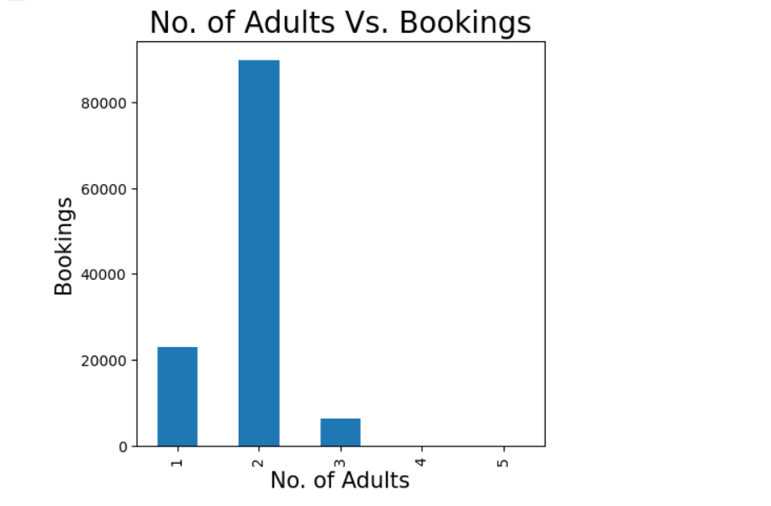
Comparison of no of adults VS Booking
Two number of adults having major bookings. The hotel should prioritize adults as they make up the majority and pay attention to other age groups as well.

Slide 13
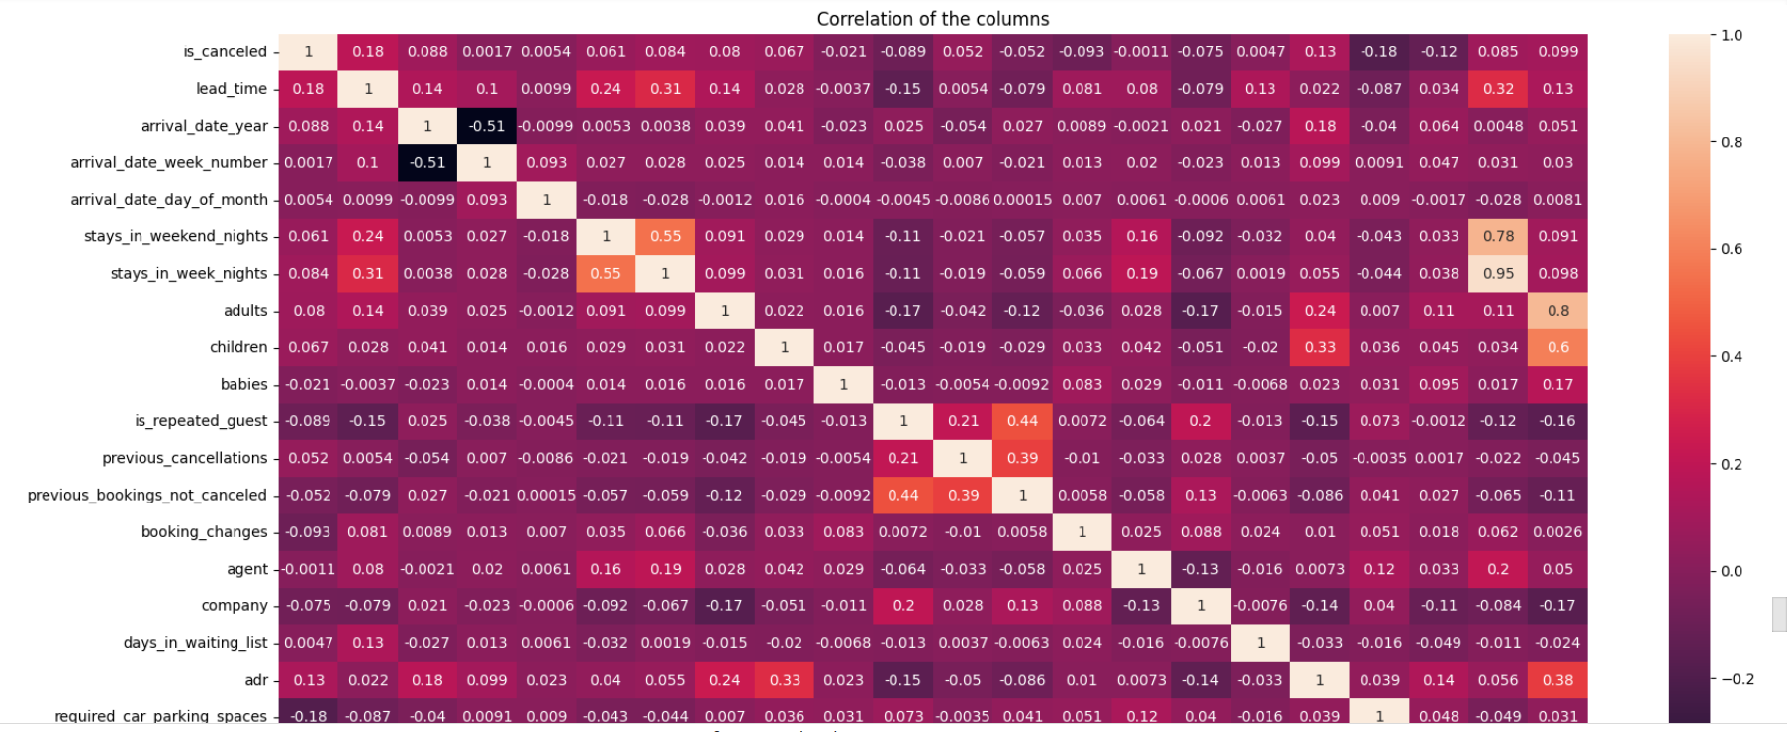
Correlation heatmap
A correlation heatmap is a graphical tool that displays the correlation between multiple variables as a color-coded matrix. arrival_date_year and arrival_date_week_number columns has negative correlation which is -0.51.stays_in_week_nights and total_stay has positive correlation which is 0.95.

Slide 14
Conclusion
1. The majority of visitors prefer the city hotel.
The most reservations were made by agent no. 9.
The percentage of returning visitors is lower, at 3.86%.
The majority of people prefer room type A.
Food of the BB type is generally favored.
July has the most reservations after August, with August having the most.
The majority of distribution channels, or 79.13%, are TA/TO.
Hotel City has the highest ADR. Revenue is increased by the highest ADR.
The year 2016 saw the highest number of bookings, totaling 42313.
Longer wait times at city hotels indicate that they are busier.
The GDS distribution channel made the largest contribution to ADR in city hotels, but not at all in resort hotels.
Less than seven days is the ideal stay duration for both types of hotels.
Not only do returning visitors not cancel their reservations, but so do regular visitors.
A higher ADR translates into higher revenue if there are more people.
There is a -0.51 negative correlation between the arrival date week number and arrival date year columns.
The correlation between stays_in_week_nights and total_stays is positive (0.95).

